Slide 1
Regression
Atul Kahate
https://www.linkedin.com/in/atulkahate/

Slide 2
Predictive Analytics
Predictive Analytics
Numeric
Categorical
Regression
Classification
Linear Regression
Logistic Regression
Decision Trees
Naïve Bayes’ Classifier

Slide 3
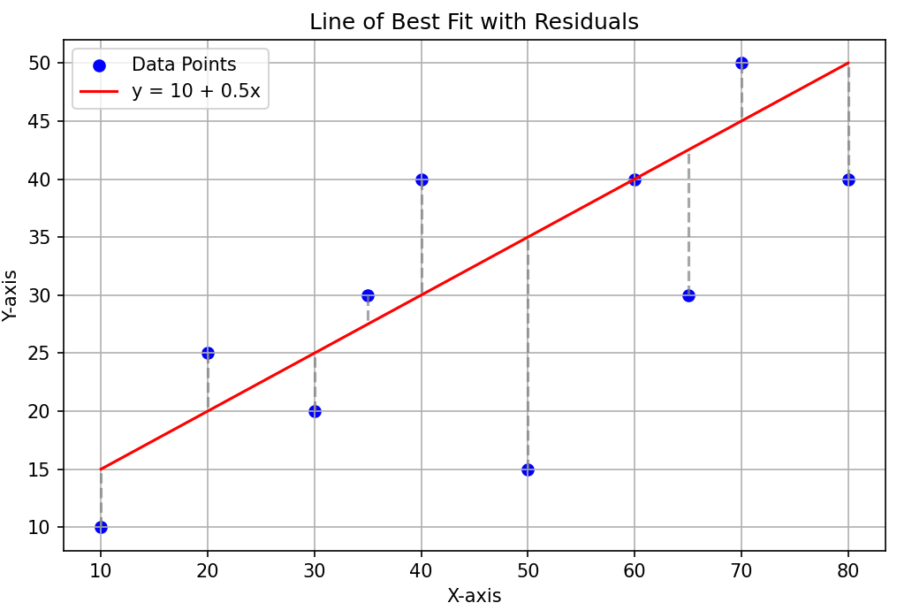
Linear Regression
Linear Regression: Find the best straight line that predicts one variable (Y) using another (X)
Equation: Y = a + bX
  a = Intercept (Value of Y when X = 0)
  b = Slope (How much Y changes for 1 unit change in X)
Understanding
  Imagine plotting our data points (X, Y) on a graph
  Draw a line that fits the points as closely as possible
  This best fit line shows the trend or relationship between X and Y
Error and Best fit
  Each point does not lie exactly on the line
  Error/Residual: Vertical distance between a point and the line
  Least Squared Error method: Try to minimize the total squared error

Slide 4
Linear Regression Interpretation and Example
If slope b > 0, Y increases as X increases
If slope b < 0, Y decreases as X increases
Suppose we study Hours of study (X) and Marks (Y)
Regression finds the line that best predicts marks for any given study hours
Slope tells us how much marks are expected to increase/decrease as per extra study hours
R² (R-Squared) = Measures proportion of variance in Y explained by X
  R = Correlation between X and Y, Range: -1 to +1
  R² = (Correlation between X and Y)² -> Squaring R removes its sign, Range: 0 to 1
  Example: R = -0.70, R² = 0.49 -> 49% of variance in Y is explained by X

Slide 5
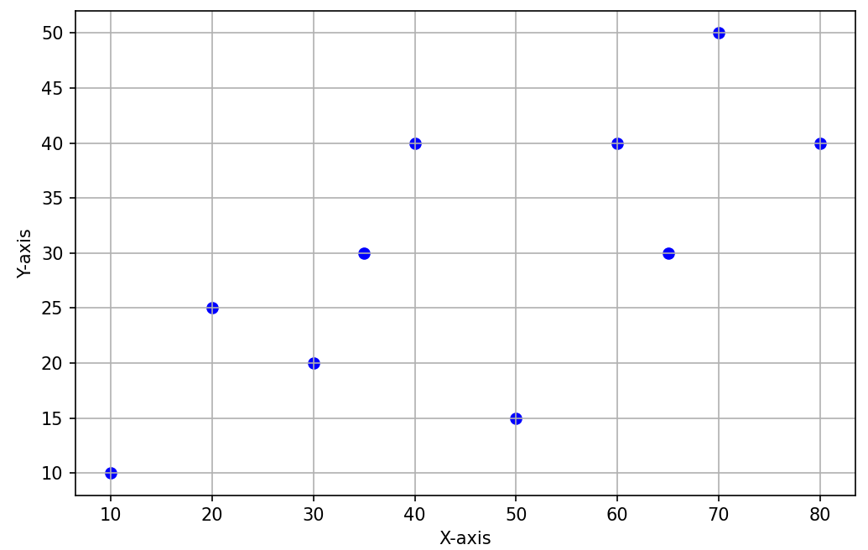
Least Squared Error
Suppose our line satisfies the equation y = 10 + 0.5x
x | y (Actual) | y (Line) | Error | Squared Error
10 | 10 | 15 | 5 | 25
20 | 25 | 20 | -5 | 25
30 | 20 | 25 | 5 | 25
35 | 30 | 27.5 | -2.5 | 6.25
40 | 40 | 30 | -10 | 100
50 | 15 | 35 | 20 | 400
60 | 40 | 40 | 0 | 0
65 | 30 | 42.5 | 12.5 | 156.25
70 | 50 | 45 | -5 | 25
80 | 40 | 50 | 10 | 100
Sum of Squared Error (SSE) |  |  |  | 862.5

Slide 6
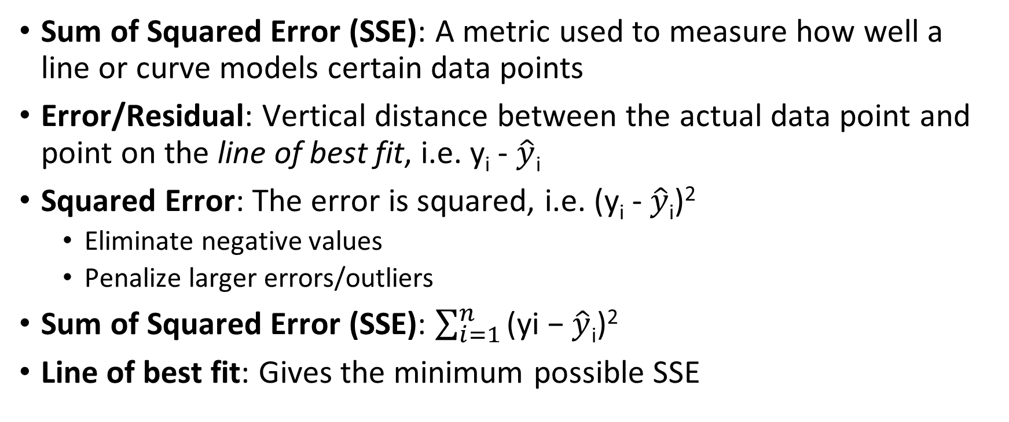
Sum of Squared Error (SSE)
Sum of Squared Error (SSE): A metric used to measure how well a line or curve models certain data points
Error/Residual: Vertical distance between the actual data point and point on the line of best fit, i.e. y_{i} - $\hat{y}\text{i}$
Squared Error: The error is squared, i.e. (y_{i} - $\hat{y}\text{i}$)²
  Eliminate negative values
  Penalize larger errors/outliers
Sum of Squared Error (SSE): $\sum_{i=1}^{n}{\text{(}\text{yi}\text{ − }\hat{y}\text{i}\text{)}\text{2}}$
Line of best fit: Gives the minimum possible SSE

Slide 7
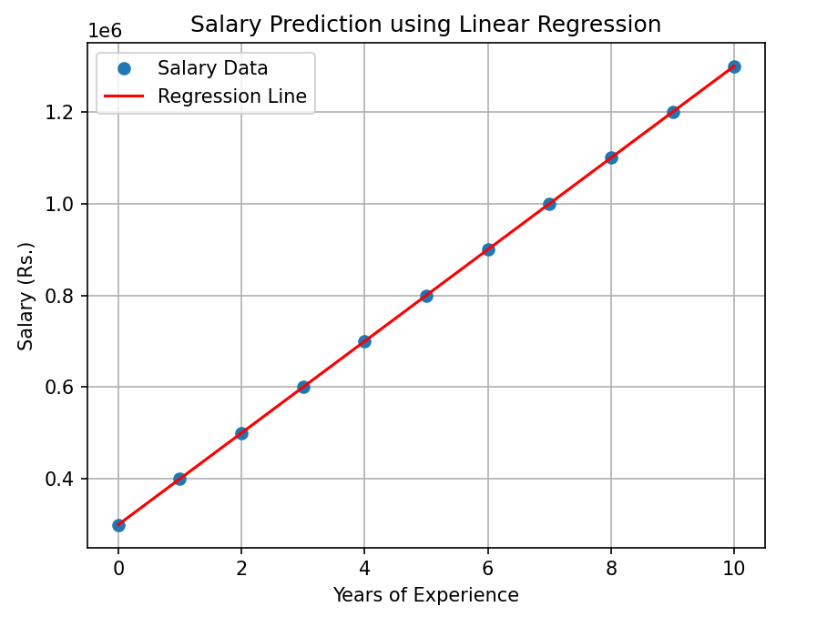
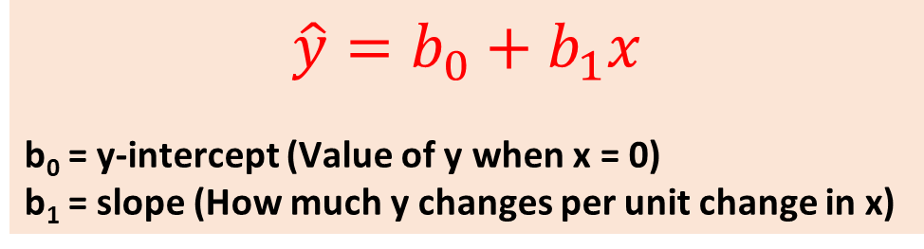
Linear Regression
Example:
Salary (y) = 3,00,000 + 1,00,000x
Here, b₀ = 3,00,000 and b₁ = 1,00,000
Experience (Years) | Salary (Rupees in Lakhs)
0 | 3
1 | 4
2 | 5
3 | 6
4 | 7
5 | 8
6 | 9
7 | 10
8 | 11
9 | 12
10 | 13
$$\hat{y}=b_{0}+b_{1}x$$
b₀ = y-intercept (Value of y when x = 0)
b₁ = slope (How much y changes per unit change in x)

Slide 8
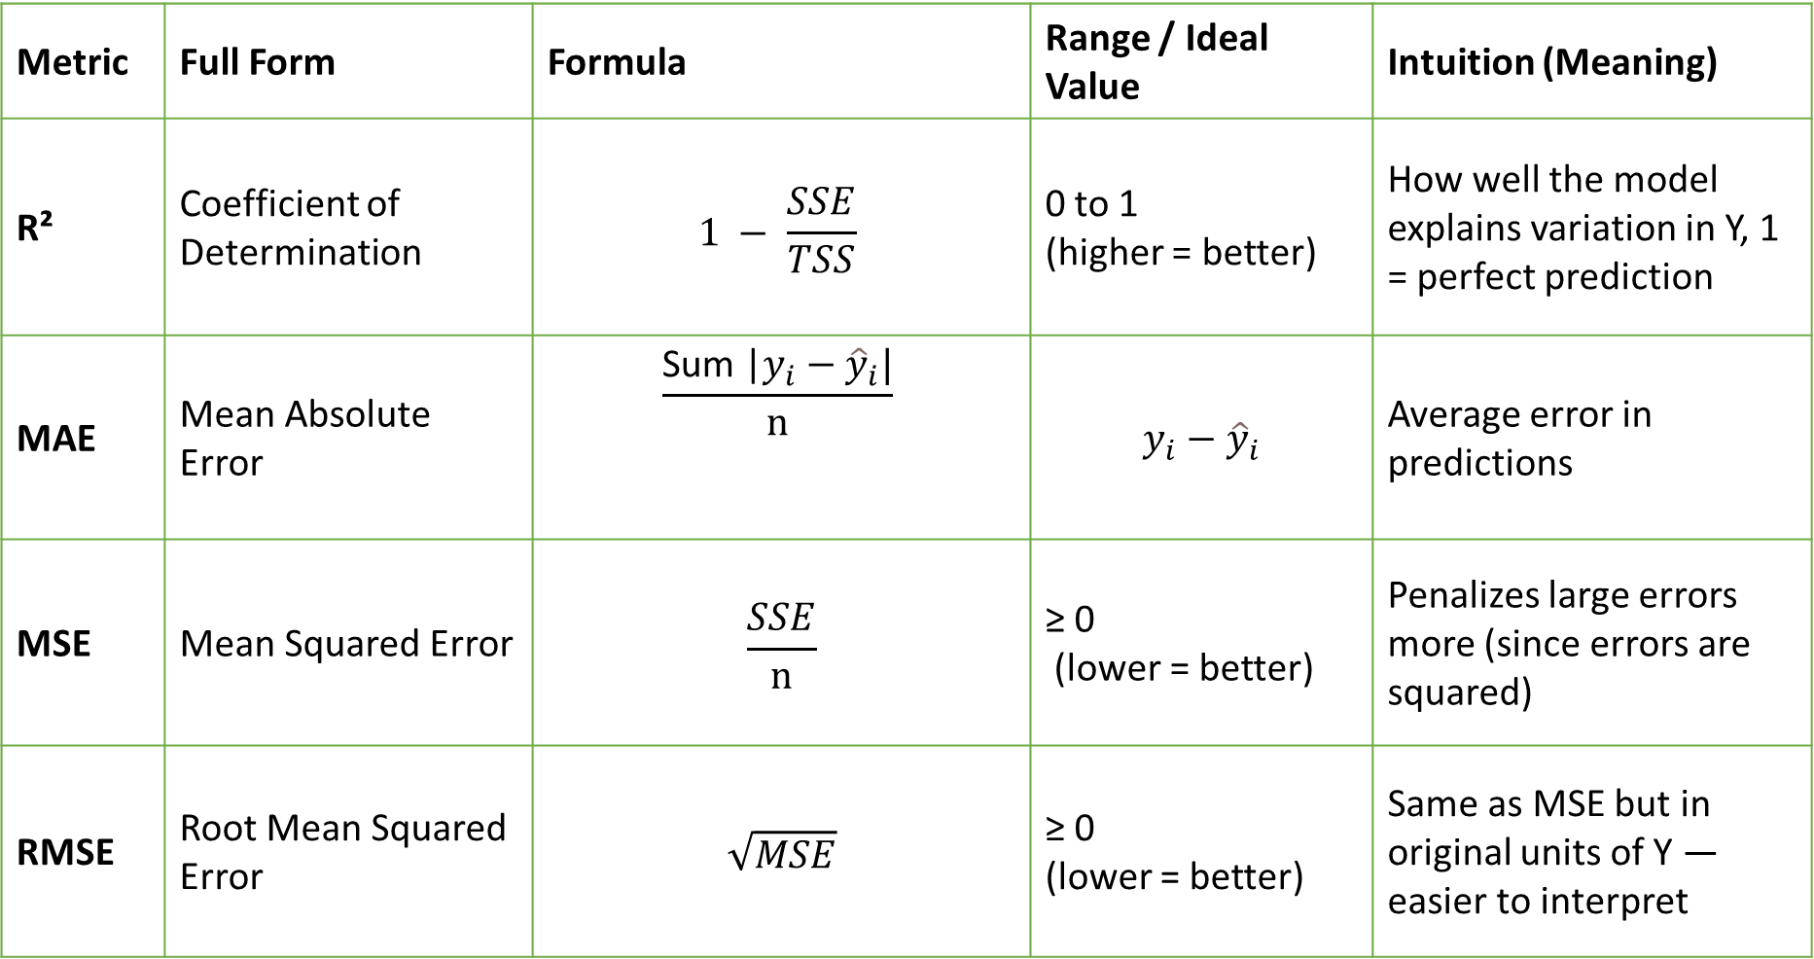
Regression Metrics Evaluation
Metric | Full Form | Formula | Range / Ideal Value | Intuition (Meaning)
R² | Coefficient of Determination | $$1 − \frac{SSE}{TSS}$$ | 0 to 1 (higher = better) | How well the model explains variation in Y, 1 = perfect prediction
MAE | Mean Absolute Error | $$\frac{\text{Sum}\text{ |}y_{i}−{\hat{y}}_{i}\text{|}}{n}$$ | $$y_{i}−{\hat{y}}_{i}$$ | Average error in predictions
MSE | Mean Squared Error | $$\frac{SSE}{n}$$ | ≥ 0 (lower = better) | Penalizes large errors more (since errors are squared)
RMSE | Root Mean Squared Error | $$\sqrt{MSE}$$ | ≥ 0 (lower = better) | Same as MSE but in original units of Y — easier to interpret

Slide 9
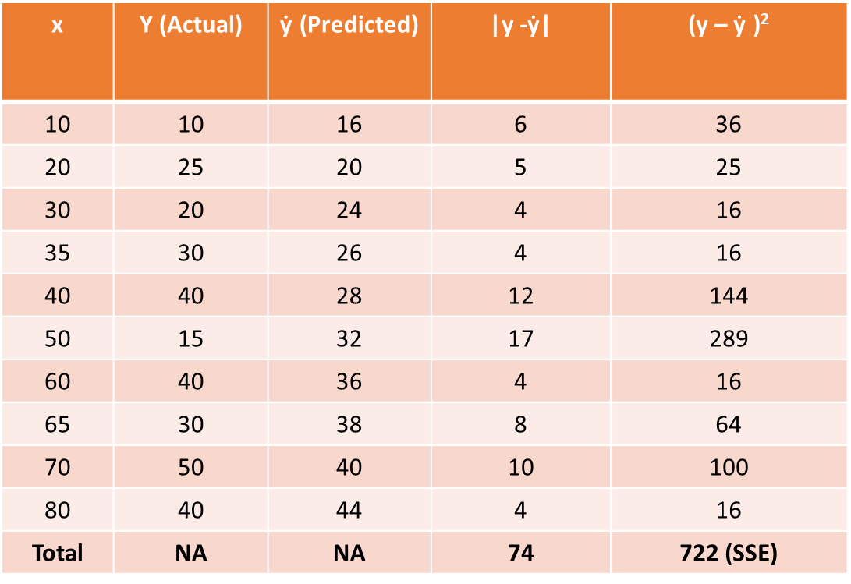

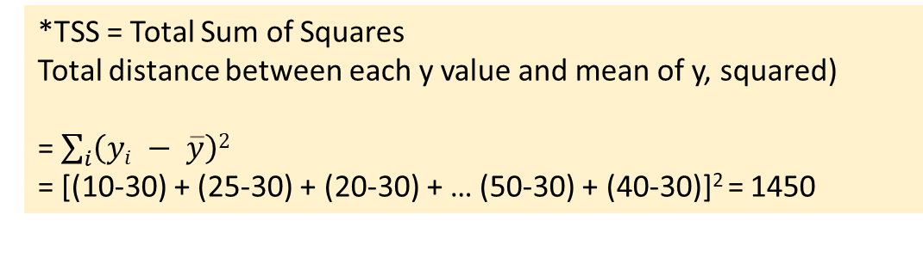
Example
x | Y (Actual) | $\text{ẏ}$ (Predicted) | |y -$\text{ẏ}\text{|}$ | (y – $\text{ẏ}$ )²
10 | 10 | 16 | 6 | 36
20 | 25 | 20 | 5 | 25
30 | 20 | 24 | 4 | 16
35 | 30 | 26 | 4 | 16
40 | 40 | 28 | 12 | 144
50 | 15 | 32 | 17 | 289
60 | 40 | 36 | 4 | 16
65 | 30 | 38 | 8 | 64
70 | 50 | 40 | 10 | 100
80 | 40 | 44 | 4 | 16
Total | NA | NA | 74 | 722 (SSE)
R² = $1 − \frac{SSE}{TSS∗}$
$\text{R}\text{2}\text{ =} 1 − \frac{722}{1450}$ = 0.502
MSE =$\frac{SSE}{n}$ = $\frac{722}{10}$ = 72.2
RMSE = $\sqrt{MSE}$ = $\sqrt{72.2}$ = 8.49
MAE = $\frac{\text{Sum}\text{ (}y_{i}−{\hat{y}}_{i}\text{)}}{n}$ = $\frac{74}{10}$ = 7.4
*TSS = Total Sum of Squares
Total distance between each y value and mean of y, squared)
= $\sum_{i}{\left(yi − \overline{y}\right)2}$
= [(10-30) + (25-30) + (20-30) + … (50-30) + (40-30)]² = 1450

Slide 10
fit_transform Versus transform
Consider
training data: [10, 20, 30, 40, 50]
test data: [60, 70, 80]
Mean of training = 30, SD of training = 15.81
Transforming training data
[10, 20, 30, 40, 50] → [-1.26, -0.63, 0, 0.63, 1.26]
Transforming test data
[60, 70, 80] → [(60-30)/15.81 ≈ 1.90, (70-30)/15.81 ≈ 2.53, (80-30)/15.81 ≈ 3.16]
But if we again fit on test data
Mean of training = 70, SD of training = 8.16
Transforming test data with its own parameters
[60, 70, 80] → [-1.22, 0, 1.22]
Result: Model “sees” test data as “normal” around its mean, instead of relative to training data
So, it pretends it knows test distribution, accuracy will be high
Training data: fit_transform()
Test/New data: transform()
fit(): Learns the parameters from data
Example: In StandardScaler, fit() would compute mean and standard deviation of the data
transform(): Apply the learned parameters on the data
Example: After learning the parameters above, scale the data
fit_transform() = fit() + transform()
Why transform() only for test data? Why not fit_transform()?

Slide 11
Prediction Problems/Issues
Problem | Observations | Reason
Underfitting | High error on training set + High error on test set | Model is too simple
Overfitting | Low error on training set + High error on test set | Model has “memorized” the noise in training set
Generalization gap
  Train versus Test Error
Bias-Variance Tradeoff
Red flags in weights
Solution: Gradually perform regularization
  Result: Training error will go up, but testing error will go down, stop when it is at the lowest
Problem | Observations
High Bias (Underfitting) | Model makes strong, wrong assumptions (e.g. fitting a straight line to data that is clearly a curve)
High Variance (Overfitting) | Model is so flexible that it changes its shape for every tiny outlier in the noise in training data
Problem | Observations
Exploding Coefficients | If weights are massive (e.g. w1 = 1000000, w2 = -999998) the model is playing a balancing act to hit every single data point
High Sensitivity | If we change one data point slightly, weights jump drastically, indicating that the model is unstable

Slide 12
Regularization: The Concept
Regularization changes the “goal” of the model
  Linear regression goal: Minimize prediction error
  Regularization goal: Minimize prediction error AND keep weights small
Model’s loss function = Total cost, Regularization adds a penalty/tax to it, based on how large the weights are
  Total cost = Prediction error + Penalty for large weights
  Prediction error = Model predictions versus Actual values (MSE)
  Penalty = Lambda x Sum of squares of weights or lambda x Sum of absolute weights, depending on which regularization technique we use
Standard regression: To predict house prices, Number of balconies helps us accurately predict a single outlier data point correctly by assigning a weight of 50,000 to this feature (Because only goal is: Reduce error)
Regularized regression: Assigning this weight comes with a massive penalty cost – The model might say, yes, it reduces my error, but adds 1000 penalty tax – not worth it

Slide 13


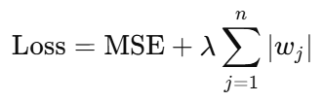

Regularization
Consider house price prediction:
Here, x1, x2, x3,… are features (Size, Age, Location, …) and w1, w2, w3, … are their intercepts/weights
When we train a model (especially linear regression), sometimes:
  The model overfits: it tries too hard to fit the training data
  This happens especially if we have many features or correlated features
Regularization: Add a penalty term to the loss function (like MSE) to shrink coefficients and reduce overfitting
Ridge Regression (L2 Regularization)
Penalty: Sum of squares of coefficients
Shrinks coefficients towards 0, but rarely makes them 0 (No feature is removed)
Example: Starting w1 = 5, w2 = 10, Ending w1 = 3.5, w2 = 7.0
Lasso Regression (L1 Regularization)
Penalty: Sum of absolute values of coefficients
Shrinks coefficients and some become 0 (Some features are removed)
Example: Starting w1 = 5, w2 = 10, Ending w1 = 0, w2 = 7
Elastic Net (L2 + L1)
Penalty: Sum of absolute values of coefficients
Balances shrinkages and feature selection
Example: Starting w1 = 5, w2 = 10, Ending w1 = 1.2, w2 = 5.8

Slide 14
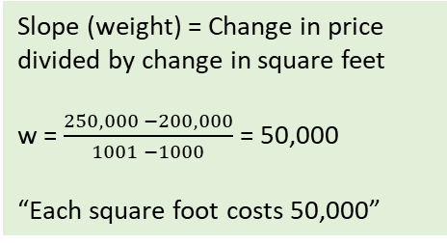
Example
The “nudge” (gradient)
Computer asks: “If I change w slightly, does the total cost go down?”
Say w = 49,900
Total cost = Error + λ(w²) =
Total cost = 1000 + (0.1 x 49,900²)
Total cost = 249,002,000 -> Reduced!
How?
Total cost = Error + λ(w²) =
Total cost = 0 + (0.1 x 50,000²)
Total cost = 250,000,000
(Error = 0 because of perfect fit, λ = A small value to start with)
Suppose we only have two training data points for housing data
Area Price
1000 200,000
1001 250,000
Slope (weight) = Change in price divided by change in square feet
w = $\frac{250,000 −200,000}{1001 −1000}$ = 50,000
“Each square foot costs 50,000”
Solution: Regularization
Possible new equation:
200,000 = (200 x 1000) + b
b = 0
Keep repeating …
At w = 200, most optimum balance between cost and error is reached
But if we go to w = 150, error jumps so much that it outweighs the cost reduction
To find bias (b), plug w back into the equation Price = (w x Area) + b; so
200,000 = (50,000 x 1000) + b
200,000 + b = 50,000,000 (50 million)
b = 50,000,000 – 200,000 = -49,800,000
The model is predicting the house price as $50 million!
Reason: w is very high
But the real price is only $200,000
To bring it back to this, we need to make the bias -49,800,000
Problem: Overfitting!
Weight is too sensitive: It thinks 1 square feet = $50,000!
Bias is ridiculous: It thinks that a 0 square feet house costs -49.8 million dollars!

Slide 15
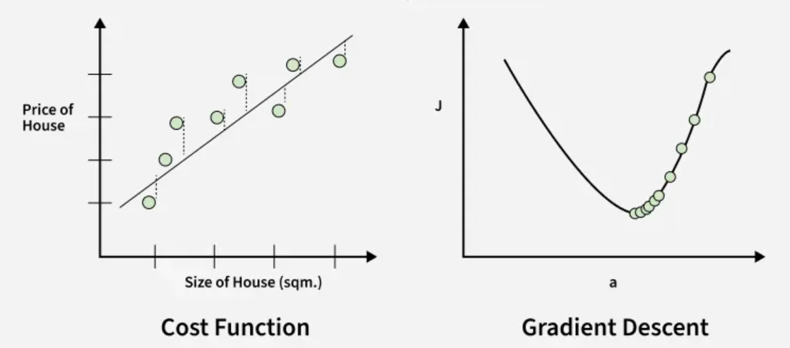
Gradient Descent

